Slide 1

Zero Waste Village
Approach Note
Sunai Consultancy Pvt. Ltd.
Date : December 2020

Slide 2
Zero Waste Village – the Mission

Slide 3
Approach of Sunai Services – 1 (waste streams)
Zero Waste | Solid waste management | Source segregation is must and non-negotiable; waste generators use 2 dustbin system; | Gila Kuda | Home composting or consumed by household animal locally. | Local community composting / Ganaura | Carriage to village level composting location (should be minimised)
 |  |  | Sukha Kuda | Fortnightly/weekly collection if wet waste is not required to be collected. | Village level material recovery. | Gram Panchayat level material recovery. | Sale of material recovered.
 |  |  | Scientific disposal of rejects and hazardous waste (about 10%).
 | Waste Water management | two pit/sokta/ aeration wetland etc. | Locally feasible treatment options of liquid waste to be identified and facilitated.
 | Fecal sludge management | Emptying local containment, transportation & treatment | Centralised treatment and support to local service providers in transporting and emptying
 | Community ownership | Ward Sabha agenda on waste disposal, sanitation, waste water. | Goals for waste free village are set and tracked by ward sabha. |  | Enforcement, tracking; social audit
 |  |  | Gram Panchayat and ward level Swachhata Samitit.
 | Capacity building – waste generators, cleaning staff and villagers | Waste generator awareness | Waste generator categories are: family, shops, cottage industries, agro industry, gathering, schools, hospitals, public places etc.) |  |  | Adults & Children learn by doing. Through experiential learning activities such as songs and competitive games, they learn about Zero Waste.
 |  | Life skill practice based orientation to school children. | Orientation to teacher | Teacher facilitate activities to children | Game and activity based approach.
 |  | Training of cleaning staff and waste management staff. | Activity based and quiz based training
 | Status report, gap analysis and DPR. | Data collect using IT based systematic easy tool. | Analysis for decision making and micro planning. |  | Presentation at Ward Sabha and Panchayat. | This can feed into DPR preparation.

Slide 4
Approach of Sunai Services – 2 (task of key actors)
Zero Waste service areas | Key services | Task of
 |  | Sunai | GP identified agency | GP/Ward | Ward Sabha – Residents | Waste generator
Management of waste (Solid and waste water) | Solid Waste collection from waste generators or collection staff – case specific approach | Technical support / execution / hybrid | Execution | Facilitation | - | Segregation, composting
 | User fee collection |  | Execution | Facilitation | - | Pay user fee
 | Running material recovery facility (MRF) & Market linkages of the material recovered |  | Execution | Facilitation | - | -
 | Waste water facility construction & maintenance (soak pit, toilets, oxidation ponds, ground water recharge pit etc.) |  | Execution | Facilitation | - | -
Ward Sabha facilitation | Participation, Collective Initiative and Ownership : village is free from waste | to facilitate ward sabha. | Response to query | Facilitation | people participate | Give response
 | Enforcement | Cooperation | - | Execution | Execution | Cooperation
Awareness and Capacity building | Awareness of waste generators - family, shops, cottage industries, agro industry, gathering, schools etc. (IEC Campaign) | Activity based campaign; one to one interaction | Communicate with waste generators | Facilitation | Facilitation | Participate
 | Capacity building and training of team engaged in solid waste and cleaning | Conduct training in discussion/practice mode | Participation | Facilitation | - | -
Planning and tracking | Data collection on status – for gap analysis with respect to the goal of Zero Waste; for uses in Plan preparation and DPR for the village. (solid and liquid waste). | Execution | - | Convene and participate | Participation | Participation
 | Analysis of status data for decision making for Gram Panchayat | Execution | - | Facilitation and user | User | -
 | Mobile app based record keeping and tracking. | Software development | User | User | - | -

Slide 5
Sunai Services
Consultancy support to achieve zero waste and ODF-plus
Direct execution / Cover larger area like districts/blocks instead of a few villages
Sustained awareness campaign on segregation at source
Residents / niwasi sabha are core of any execution related to Waste Management and achieving zero waste.
Status report and gap analysis on sanitation : solid waste, grey water, black water and toilets.
Detailed Project Report – DPR preparation

Slide 6
Sunai Initiatives
Zero Waste information website in Hindi
Application for resident : niwasi.in
Status Report on Resident’s awareness on Sanitation practices
Process documents and IEC tools
Agenda driven Niwasi Sabha process

Slide 7
Estimate of resource for 1 block
Niwasi Sabha facilitation team : 1 person for the block for entire project period (Note – no budgetary support needed for this.)
Capacity building and awareness generation team : 2 persons team for every 4 Gram Panchayats for first 2 months; 2 persons afterwards for whole block.
Solid waste team for collection of dry waste and running material recovery facility : 1 person with 1 vehicle for every 4 Gram Panchayats. Fortnightly collection of segregated dry waste. (Note – no budgetary support needed for this)
Status report and gap analysis for sanitation:
  a) Consultant team of 2 persons for analysis, report preparation and consultation.
  b) Data collection team of 6 persons for 2 Gram Panchayats. Sunai data collection team will collect data for 2 gram panchayats but it will guide other resources (from GP or Jeevika) to collect data from other gram panchayats of the block using similar tools and processes.
  c) Scope of the status report will be these aspects of sanitation : solid waste, liquid waste (grey water and black water), toilets, faecal sludge.

Slide 8
Sunai credential
Sunai Waste Management services run on the principles of Zero-Waste and Niwasi Sabha (Milen to Sahi… Baaten to Hon...)
Sunai experience :
SUNAI is empanelled by Urban Development Department, Govt. of Uttar Pradesh for Solid Waste Management services for smaller cities .
Sunai is providing services to Magadh Mahila College and Patna University
Sunai served 1500 families in Danapur near Patna for about 1 year.
Sunai established and operated compost cum material recovery facility at Balua village to cater to Danapur intervention.
Sunai is partner of Development Management Institute (DMI), Patna, in action research development project towards Clean and Green Panchayat.
Sunai promotes home composting in housing buildings.

Slide 9
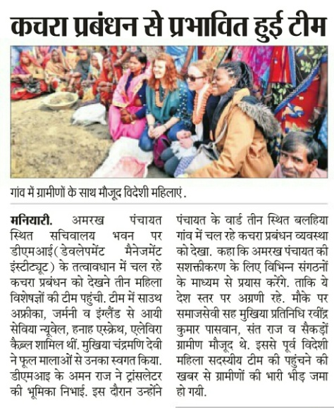
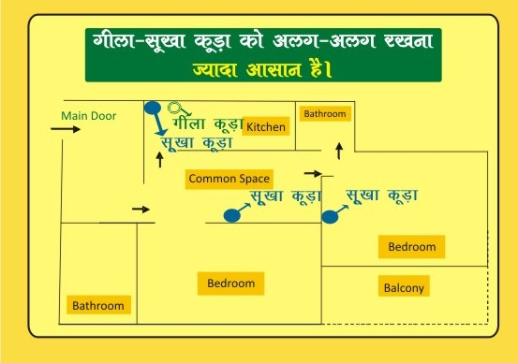
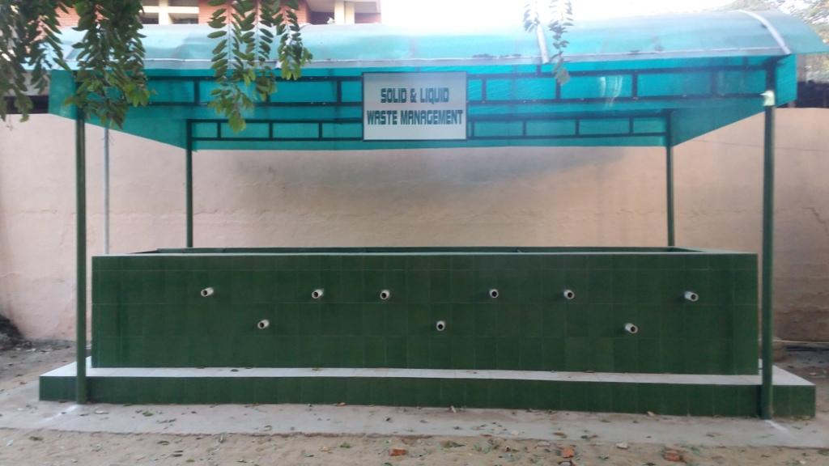
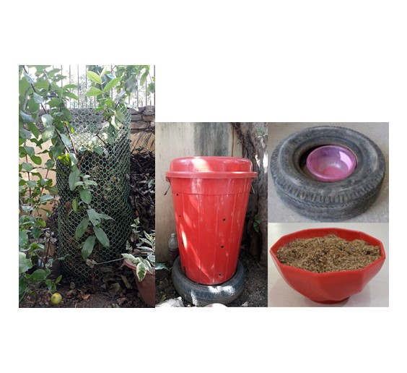
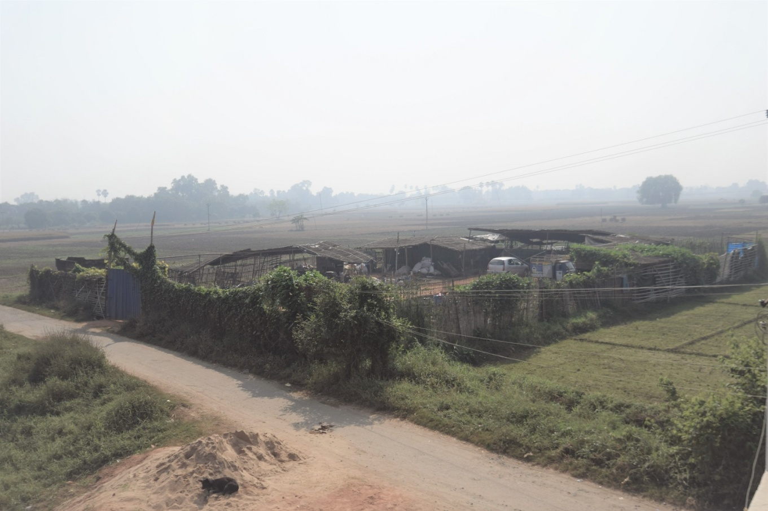
Compost unit at Magadh Mahila College, Patna
Compost cum material recovery facility at Balua to feed Danapur solid waste services of Sunai (was operational for 1.5 years).
Compost unit – left for dry leaf and another for kitchen waste at a building in Patna.

Slide 10
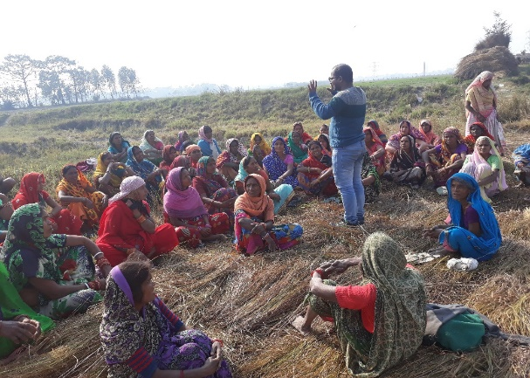
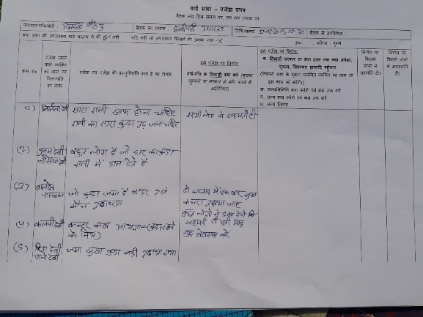
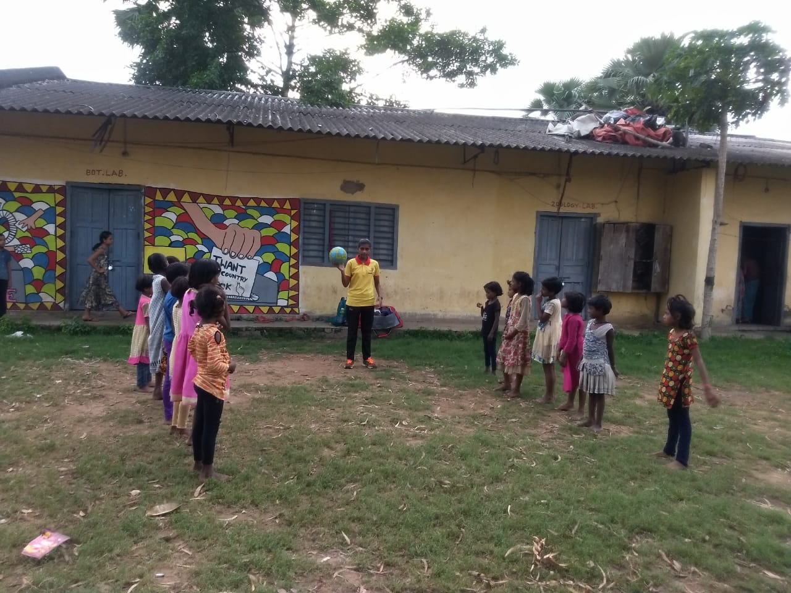
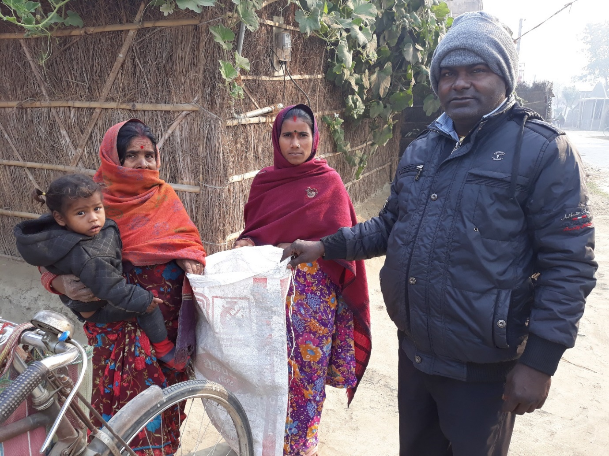
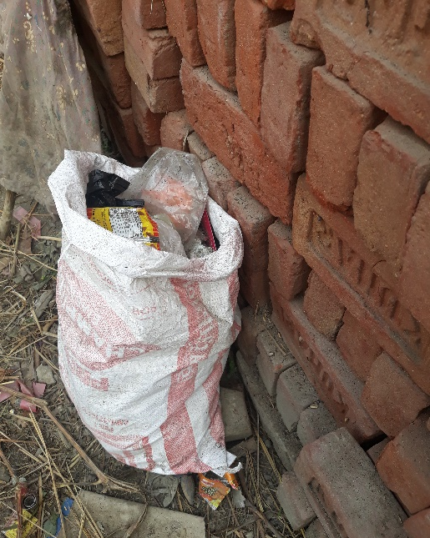
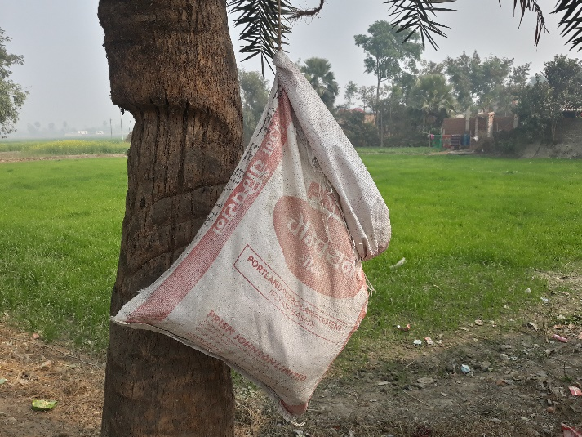
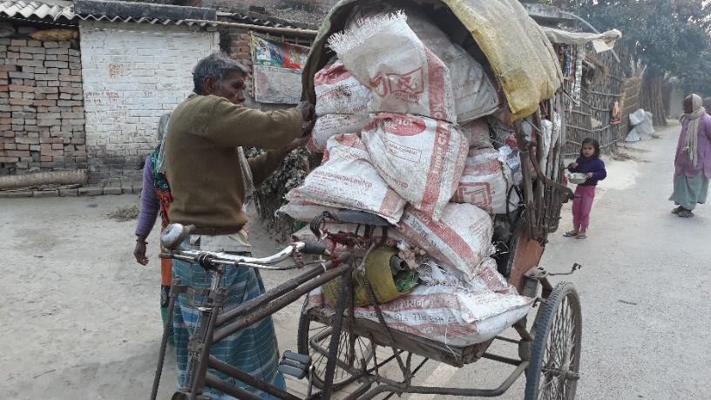
Experience of Sunai in a village
A Ward Sabha meeting in Ward no. 3
Agenda and decision at one Ward sabha
Using Sports to teach children about Zero Waste in a government school.
Villagers are supported with a cement bag for storing dry waste
Dry waste container
Dry waste container
Fortnighly collection of dry waste

Slide 11
Information from ground rural area Bihar
(Sample size 1042, 15 districts, 492 women and 550 men respondents, from all social groups and economic groups.
माता जी बोल रही है शौचालय का इस्तेमाल काहे करते हो जल्दी भर जायेगा, शौचालय महिलाओं के लिए बना है ו बाहर खुले खेत में जाओगे तो सैर सपाटा भी हो जायेगा ו
रमेश जी बाहर खुले में शौच जाने का आनन्द ही कुछ और है ו
ऐसे सामान्य विचार आंकड़ा में परिलक्षित हो रहा है ו
83% लोग मानते हैं कि मक्खियों के द्वारा घर में मल वापस आ जाता है ו
परन्तु साथ ही 77% लोग बोलते हैं कि सामान्य लोग खुले में शौच जाते हैं ו सिर्फ 2%लोगो को सोचना है कि लोग खुले में शौच नहीं जाते हैं, और 21%लोगो का कहना है कि लगभग न के बराबर (कुछ ) लोग खुले में शौच जाते हैंו 14%लोगों का तो कहना है कि लगभग सभी लोग खुले में शौच जाते हैं ו
एक या दो कमरे वाले 50% घर में शौचालय नहीं है ו तीन कमरे वाले 14% घर में शौचालय नहीं है ו कुल मिलकर एक तिहाई घरों में शौचालय नहीं है ו
जिन घरों में शौचालय है उनमे से 22% लोग खुले में शौच जाते हैं ו
लगभग 40% लोगों का कहना है कि सरकारी सहायता के बारे में कोई विचार नहीं है या सरकारी सहायता में से ज्यादा से ज्यादा पैसा बचा लें ו
9% घरों में ही टू पिट शौचालय है जो चालू हालत में है ו जबकि टू पीट शौचालय वाले उत्तरदाता में 34% मानते हैं कि सबसे स्वच्छ शौचालय टू पिट शौचालय है ו

Slide 12
Report from ground – Toilet & open defecation

Slide 17
Open for discussion

